Slide 1


Slide 2
A Generic View of Process
Chapter 2

Slide 3
What is it?
  A series of predictable steps-a road map that helps you create a timely, high-quality result. The road map that you follow is called a software process
Who does it?
  Software engineers and their managers adopt the process to their needs and then follow it.
Why is it important?
  Because it provides stability, control, and organization to an activity that can, if left uncontrolled, become quite chaotic. However, a modern software engineering approach must be “agile”.
What are the steps?
  At a detailed level, the process that you adopt depends on the software that you’re building

Slide 4
Software
Instructions
Data structures
Documents

Slide 5
Engineering
Solution to practical problems
The analysis, design, construction, verification and management of technical (or social) entities.
Sequence of well defined, precisely-stated sound steps, which follow method or apply technique based on some combination of
Theoretical results derived from a formal method
Empirical adjustments for unmodeled phenomenon
Rules of thumb based on experience

Slide 6
What is Software Engineering?
Definition proposed by Fritz Bauer
  Software engineering is the establishment and use of sound engineering principles in order to obtain economically software that is reliable and works efficiently on real machines.

Slide 7
Definition (contd.)
Software Engineering [IEEE]:
  The application of a systematic, disciplined, quantifiable approach to the development, operation, and maintenance of software; that is, the application of engineering to software
  The study of above approaches

Slide 8
Definition (contd.)
Software Engineering [Sommerville]:
  An engineering discipline concerned with all aspects of software production.

Slide 9
Software Engineering: A Layered Technology
Tools
Methods
Process
A Quality Focus

Slide 10
Software Process
Process
Series of predictable steps-a road map that helps create a timely and high quality entity
Software Process is a framework for the tasks that are required to build high quality software

Slide 11
Methods & Tools
Methods: Technical how-to’s for building software
Tools: Provision of automated or semi-automated support for the process and the methods.

Slide 12
Process Framework
Establishes the foundation for a complete software process by identifying a small number of framework activities that are applicable to all software projects, regardless of their size or complexity.
Encompasses a set of umbrella activities that are applicable across the entire software process.

Slide 13
Each framework activity is populated by a set of software engineering actions--- a collection of related tasks that produces a major software engineering work product (e.g. design is a software engineering action)
Each action is populated with individual work tasks that accomplish some part of the work implied by the action.

Slide 14
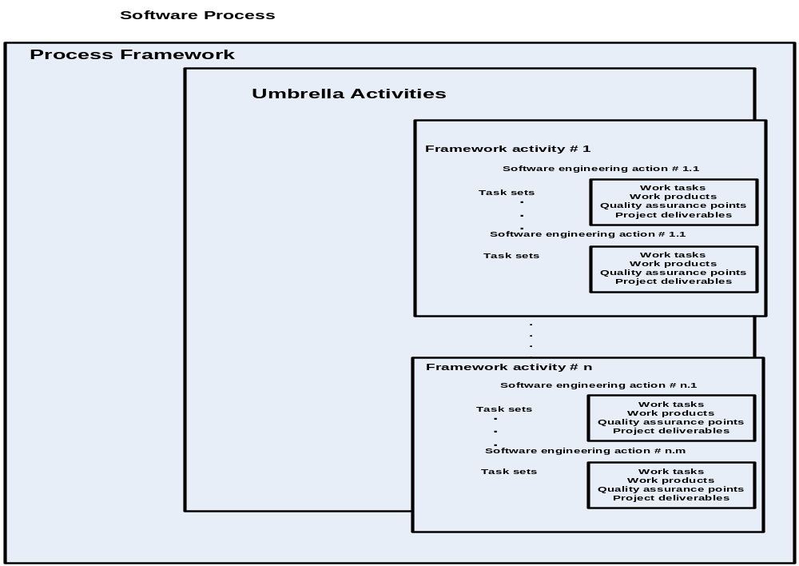

Slide 15
Generic process framework
Made of following FRAMEWORK ACTIVITIES
  Communication
  Planning
  Modeling
  Construction
  Deployment

Slide 16
An Example
Modeling-(Framework activity)
  Analysis-(Software engineering action)
    Requirements gathering-(work task)
    Elaboration-(work task)
    Negotiation-(work task)
    Specification-(work task)
    validation-(work task)
    Analysis model-(work product)
    Quality assurance points
    milestones

Slide 17
An Example
Modeling-(Framework activity)
  Design-(Software engineering action)
    Data design-(work task)
    Architectural design-(work task)
    Interface design-(work task)
    Component-level design-(work task)
    Design model-(work product)
    Quality assurance points
    milestones

Slide 18
Umbrella Activities
Software project tracking and control
Risk management
Software quality assurance
Formal technical reviews
Measurement
Software configuration management
Reusability management
Work product preparation and production

Slide 19
Process Assessment and Improvement
Standard CMMI Assessment Method for Process Improvement
CMM-Based Appraisal for Internal Process Improvement
SPICE
ISO 9001:2000 for Software

Slide 20
References
Software Engineering-Chapter 1 & 2
  By Roger S. Pressman
  ^{7th} edition

